Slide 1


Slide 3







Overview
12
weeks
Full stack web-based system using Hybrid Machine Learning for detecting and classifying Malicious attacks.
Designed to detect both known and unseen threats, trained using public Datasets
Whole Process includes:
Information researching
Architecture diagrams
Wireframe and prototyping
Implementation, coding, development and testing.
All done in 12 weeks' timeframe.

Slide 4

Project Background
This project focuses on using three tier web system to detect and classify modern malware using hybrid AI models.
It overcomes the limits of rule-based systems by using behaviour-driven analysis to catch threats that evolve or bypass traditional security. (Aboaoja et al. 2022).
Hybrid Machine Learning models improve anomaly detection by combining multiple techniques for higher accuracy and efficiency. (Ariffin & Razak, 2020).
Web Application based setup with public datasets supports real-time threat detection. This approach enables efficient testing, behavioural analysis, and improved malware classification accuracy (Alqahtani et al., 2023).
Summarise what pj about, summarise in bullet,

Slide 5
Project Scope and Objectives
Scope | Objectives
Design and implement a web-based system for detecting and classifying malicious attacks using Hybrid ML models. | Develop Web application and Hybrid ML models to enhance detection accuracy and threat prediction.
Explore and use public datasets to train and evaluate ML models. | Identify relevant public datasets for malware and attack type classification.
Use different Techniques for behaviour analysis and visual tools to predict threats early and support security decisions. | Use different machine learning algorithms to detect different types of cyber-attacks and detect unusual behaviour for early threat warning.
Ensure the system is easy at use and suitable for real-time threat analysis. | Implement a functional, web-based system that integrates data input, model prediction and analysis, and result visualisation.
1
2
3
4

Slide 6
Project Outcome/Deliverables
Outcome
Three unique Hybrid ML models trained to detect, classify and predict multiple threats using publicly available datasets.
Three Different functional web applications integrating three different ML models with different techniques, to allow real use case through interface.
A final team project presentation and demonstration, showcasing system features, model performance, and real usage.
Documentation covering system architecture, data sources, ML model development, and instructions for deployment and usage.
1
2
3
4

Slide 7
Design 1 Design 1 GitHub Repository link: https://github.com/Arun-2208/TIP-Project-1
Design Concept
What It Does
Key Technical Features
Constraints
Full Stack Web application system that detects and classifies three types of malwares:
Trojan malware
Ransomware attacks
Spyware intrusions
It also does anomaly detection and future risk prediction.
Frontend – Vue, API layer – Python Flask
Machine Learning – Keras , Tensorflow
Hybrid AI model – Autoencoder for Anomaly Detection and Random forest for classification.
Stores each scan in a MySQL database linked to the user.
User and Admin Features:
Scan files, view history, download PDF reports
Admin only Features:
Update datasets, retrain the model, view analytics dashboard
Threshold Tuning: Low values caused false alerts; high values missed threats.
Model Compatibility: Retrained models had to match live setup exactly to avoid load failures.
Frontend Sync: Charts and reports had to stay in sync with backend predictions to prevent display issues.
Notes:
Multi-threat Detection System: Comprehensive security solution that can identify three different types of cyber threats:
SQL Injection (SQLi) attacks
Phishing/SMS scam attempts
Distributed Denial of Service (DDoS) attacks
Key Features:
Initial attack classification system to identify threat type
Specialized ML models for each threat category
Real-time detection and analysis
User-friendly web interface with authentication
Dashboard with visualization and metrics
API endpoints for integration with other systems
Implementation Details
Architecture:
Flask-based backend with MongoDB
ML models implemented in Python using scikit-learn
JWT-based authentication system
RESTful API design
Model Metrics:
Attack Classifier: Multi-class classification model that identifies attack type
Uses TF-IDF vectorization and NLTK for text preprocessing
Confidence level reporting (High/Medium/Low)
SQL Injection Detector:
Ensemble model combining Naive Bayes and Logistic Regression
Voting classifier with soft voting strategy
Binary classification (Safe Query vs. SQL Injection)
Performance metrics include accuracy, precision, recall, F1 score, and AUC-ROC
Phishing/SMS Detector:
Ensemble model combining Naive Bayes and Logistic Regression
Text preprocessing with NLTK
Binary classification (Safe Message vs. Malicious Message)
Adjustable threshold for borderline cases (0.4-0.6 probability)
DDoS Detector:
Voting classifier with advanced feature encoding
Numerical data scaling and feature selection
Binary classification (BENIGN vs. DDoS)
Probability scores for both classes

Slide 8
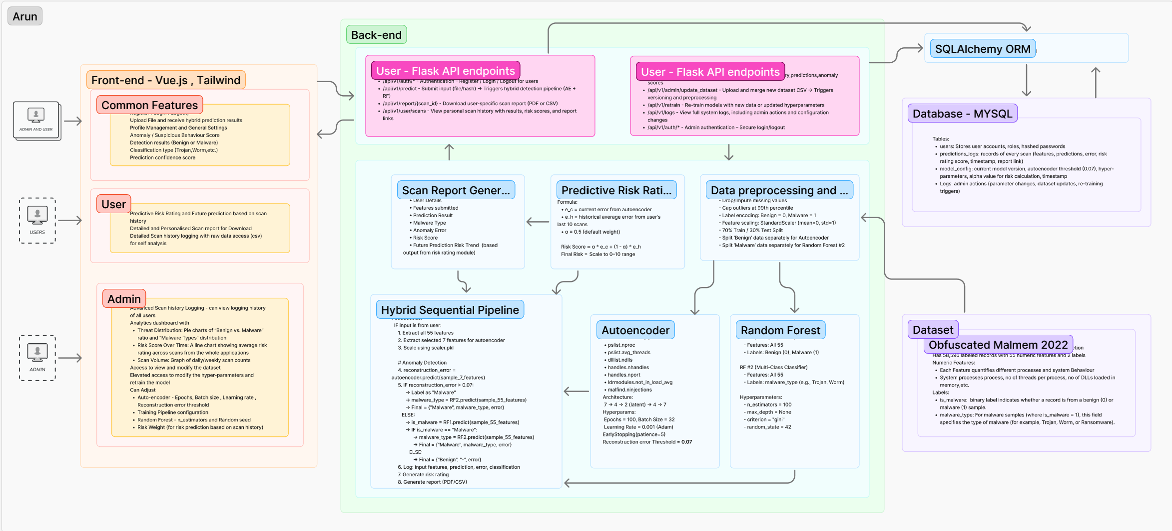

Design 1
System Design Architecture

Slide 9
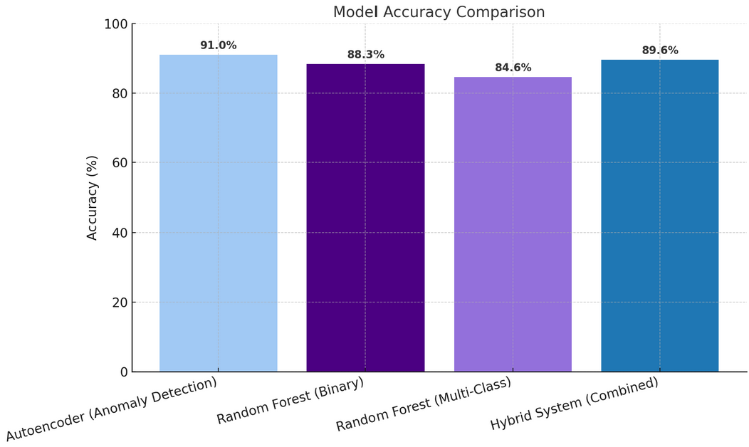
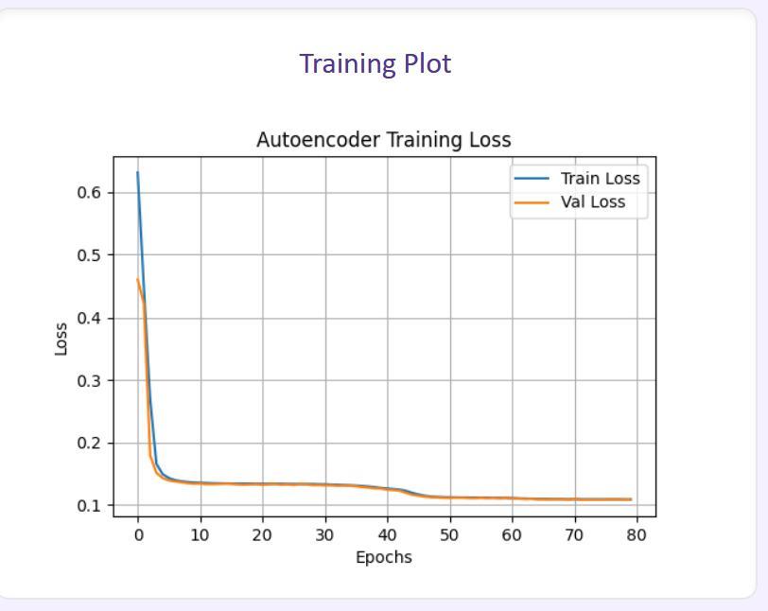
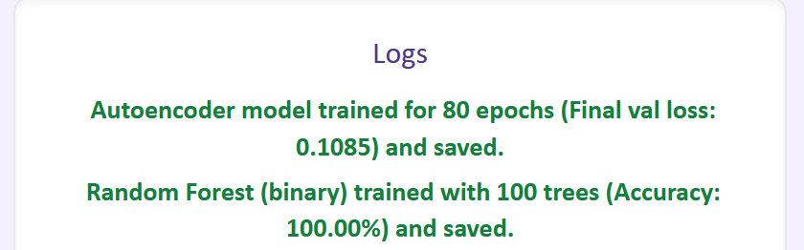
Design 1
Implementation Details
Model Accuracy – Individual vs Combined
Auto Encoder Training - Loss vs Epochs

Slide 10
Design 2 Design 2 GitHub Repository link: https://github.com/VatanaChhorn/TIP-Project-2
Design Concept
What It Does
Key Technical Features
Limitation
Comprehensive security solution that can identify three different types of cyber threats:
SQL Injection (SQLi) attacks
Phishing/SMS scam attempts
Distributed Denial of Service (DDoS) attacks
Frontend: React
Backend: Flask, MongoDB,
ML: scikit-learn
Initial threat classification system
Specialized ML models per threat type
Real-time detection & analysis
Secure, user-friendly web interface
Dashboard with visualizations & metrics
API integration support
Only accepts CSV input
Limited to 3 threat types: SQLi, Phishing (SMS), DDoS
No support for adding new threats without code changes
Notes:
Multi-threat Detection System: Comprehensive security solution that can identify three different types of cyber threats:
SQL Injection (SQLi) attacks
Phishing/SMS scam attempts
Distributed Denial of Service (DDoS) attacks
Key Features:
Initial attack classification system to identify threat type
Specialized ML models for each threat category
Real-time detection and analysis
User-friendly web interface with authentication
Dashboard with visualization and metrics
API endpoints for integration with other systems
Implementation Details
Architecture:
Flask-based backend with MongoDB
ML models implemented in Python using scikit-learn
JWT-based authentication system
RESTful API design
Model Metrics:
Attack Classifier: Multi-class classification model that identifies attack type
Uses TF-IDF vectorization and NLTK for text preprocessing
Confidence level reporting (High/Medium/Low)
SQL Injection Detector:
Ensemble model combining Naive Bayes and Logistic Regression
Voting classifier with soft voting strategy
Binary classification (Safe Query vs. SQL Injection)
Performance metrics include accuracy, precision, recall, F1 score, and AUC-ROC
Phishing/SMS Detector:
Ensemble model combining Naive Bayes and Logistic Regression
Text preprocessing with NLTK
Binary classification (Safe Message vs. Malicious Message)
Adjustable threshold for borderline cases (0.4-0.6 probability)
DDoS Detector:
Voting classifier with advanced feature encoding
Numerical data scaling and feature selection
Binary classification (BENIGN vs. DDoS)
Probability scores for both classes

Slide 11
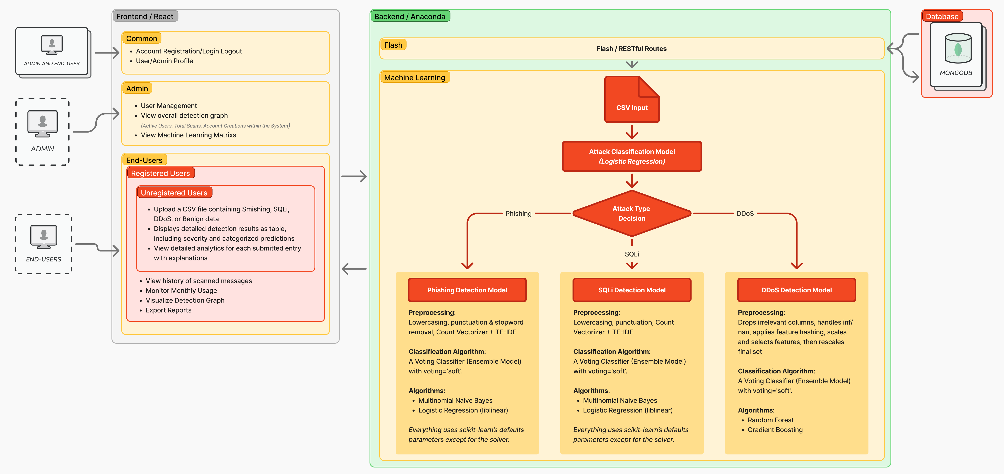
Design 2
System Design Architecture
Notes:
Multi-threat Detection System: Comprehensive security solution that can identify three different types of cyber threats:
SQL Injection (SQLi) attacks
Phishing/SMS scam attempts
Distributed Denial of Service (DDoS) attacks
Key Features:
Initial attack classification system to identify threat type
Specialized ML models for each threat category
Real-time detection and analysis
User-friendly web interface with authentication
Dashboard with visualization and metrics
API endpoints for integration with other systems
Implementation Details
Architecture:
Flask-based backend with MongoDB
ML models implemented in Python using scikit-learn
JWT-based authentication system
RESTful API design
Model Metrics:
Attack Classifier: Multi-class classification model that identifies attack type
Uses TF-IDF vectorization and NLTK for text preprocessing
Confidence level reporting (High/Medium/Low)
SQL Injection Detector:
Ensemble model combining Naive Bayes and Logistic Regression
Voting classifier with soft voting strategy
Binary classification (Safe Query vs. SQL Injection)
Performance metrics include accuracy, precision, recall, F1 score, and AUC-ROC
Phishing/SMS Detector:
Ensemble model combining Naive Bayes and Logistic Regression
Text preprocessing with NLTK
Binary classification (Safe Message vs. Malicious Message)
Adjustable threshold for borderline cases (0.4-0.6 probability)
DDoS Detector:
Voting classifier with advanced feature encoding
Numerical data scaling and feature selection
Binary classification (BENIGN vs. DDoS)
Probability scores for both classes

Slide 12
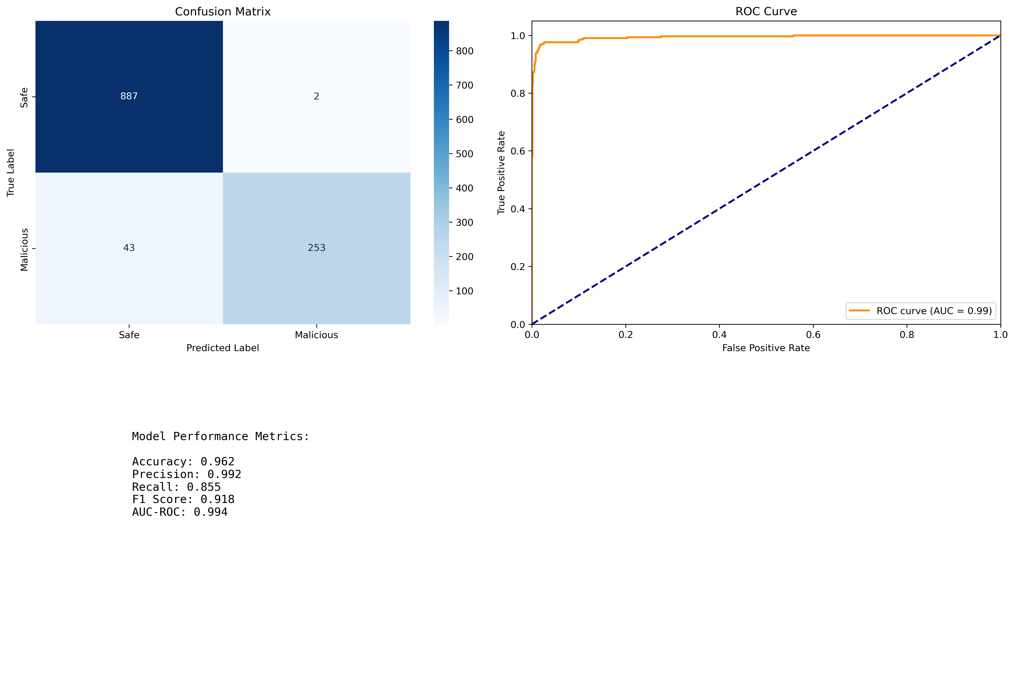
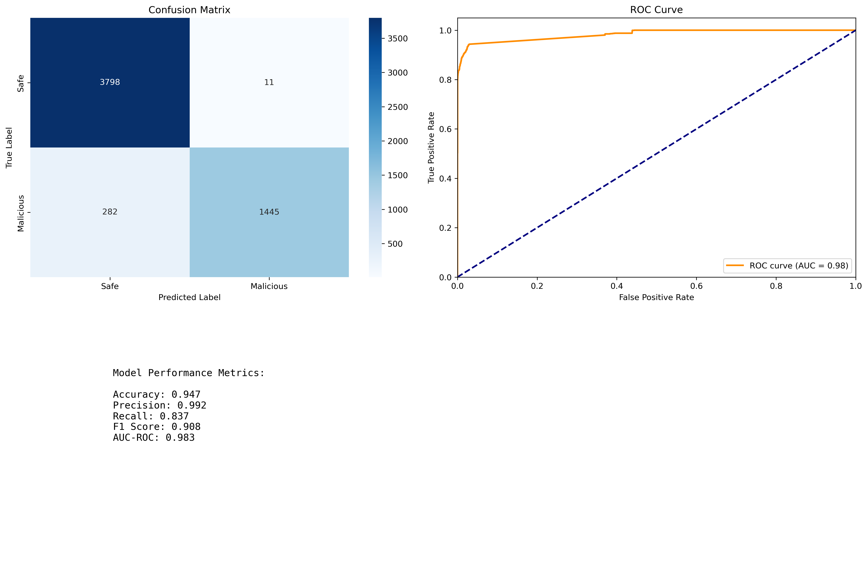
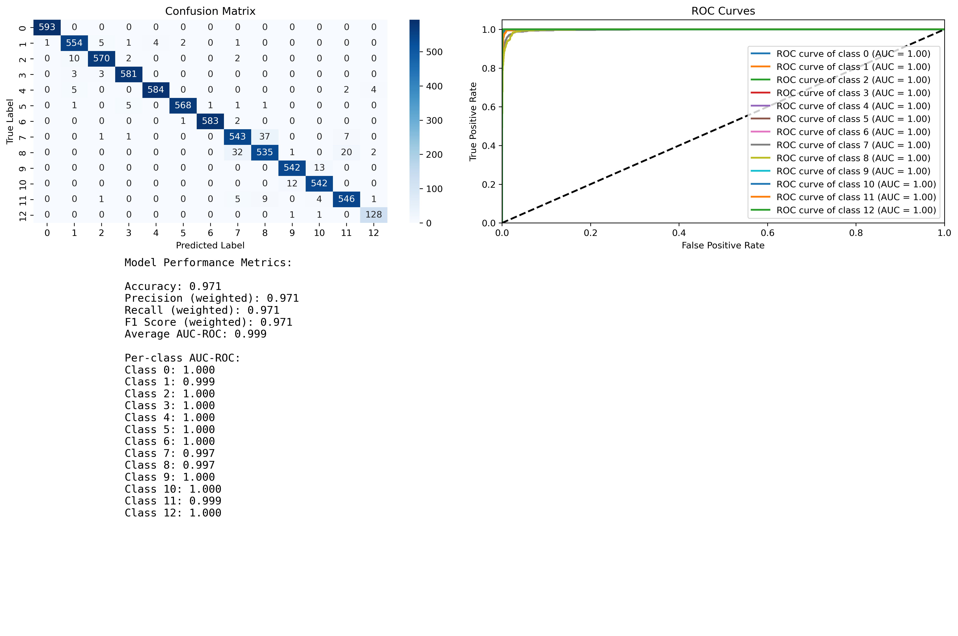
Design 2
Implementation Details
SQL Injection Detector
DDoS Detector
Smishing Detector Model
SQLi Detector Model
DDoS Detector Model
Notes:
HashingVectorizer
n_features=20
Why: collapsed millions of possible categories into a tiny fixed space to save memory and speed up training.
alternate_sign=False
Why: kept all hashed counts non-negative so downstream scalers and models see “pure” feature magnitudes.
FeatureSelector (ExtraTreesClassifier)
n_estimators=250
Why: more trees gave smoother, more stable feature-importance rankings for selecting the top 40 features.
random_state=42
Why: ensures your pipeline always picks the same features—essential for reproducibility.
RandomForestClassifier
n_estimators=200 (vs. 100 default)
max_depth=20, min_samples_split=5, min_samples_leaf=2
class_weight='balanced'
n_jobs=-1, random_state=42
Why: these together cap over-complexity, handle class imbalance, and leverage all CPU cores while guaranteeing reproducible splits.
GradientBoostingClassifier
n_estimators=200, subsample=0.8, max_depth=8
(the other settings—learning_rate=0.1, min_samples_…—match defaults)
Why: using more trees, slight stochasticity (80% subsampling), and deeper trees let the ensemble capture complex patterns with reduced variance.
VotingClassifier
voting='soft', weights=[1,1]
Why: averaging each model’s predicted probabilities (“soft” voting) reliably boosts overall accuracy over a simple majority vote.
Threshold for anomaly
Reconstruction-error ≥ 0.07
Why: this cutoff was picked on validation data to balance false alarms vs. missed attacks.

Slide 13
Design 3 Design 3 GitHub Repository: https://github.com/VatanaChhorn/TIP-Project-3
Design Concept
What It Does
Key Technical Features
Limitation
Scans files for malicious software through a web browser
Identifies and classifies 5 malware types
Provides color-coded threat level indicators
Maintains secure user accounts and scan history
Frontend: HTML CSS
Backend: Flask REST API
Machine Learning: Random Forest + SVM
Database: JSON, .pkl files
Dual detection methods for higher accuracy
Detailed threat classification (not just binary detection)
User dashboard with scan history and reporting
No installation required (browser-based)
Supports only .bytes file format
Scan speed depends on file size and device performance
Limited to 5 pre-defined malware categories
Requires both detection systems to function

Slide 14
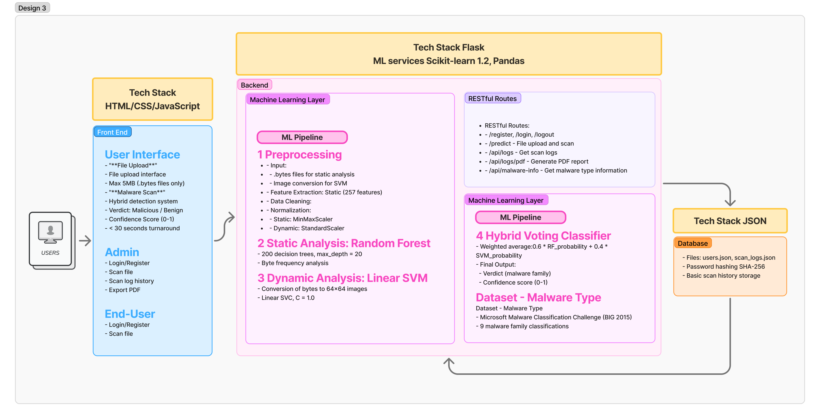
Design 3
System Design Architecture
Notes:
Multi-threat Detection System: Comprehensive security solution that can identify three different types of cyber threats:
SQL Injection (SQLi) attacks
Phishing/SMS scam attempts
Distributed Denial of Service (DDoS) attacks
Key Features:
Initial attack classification system to identify threat type
Specialized ML models for each threat category
Real-time detection and analysis
User-friendly web interface with authentication
Dashboard with visualization and metrics
API endpoints for integration with other systems
Implementation Details
Architecture:
Flask-based backend with MongoDB
ML models implemented in Python using scikit-learn
JWT-based authentication system
RESTful API design
Model Metrics:
Attack Classifier: Multi-class classification model that identifies attack type
Uses TF-IDF vectorization and NLTK for text preprocessing
Confidence level reporting (High/Medium/Low)
SQL Injection Detector:
Ensemble model combining Naive Bayes and Logistic Regression
Voting classifier with soft voting strategy
Binary classification (Safe Query vs. SQL Injection)
Performance metrics include accuracy, precision, recall, F1 score, and AUC-ROC
Phishing/SMS Detector:
Ensemble model combining Naive Bayes and Logistic Regression
Text preprocessing with NLTK
Binary classification (Safe Message vs. Malicious Message)
Adjustable threshold for borderline cases (0.4-0.6 probability)
DDoS Detector:
Voting classifier with advanced feature encoding
Numerical data scaling and feature selection
Binary classification (BENIGN vs. DDoS)
Probability scores for both classes

Slide 15
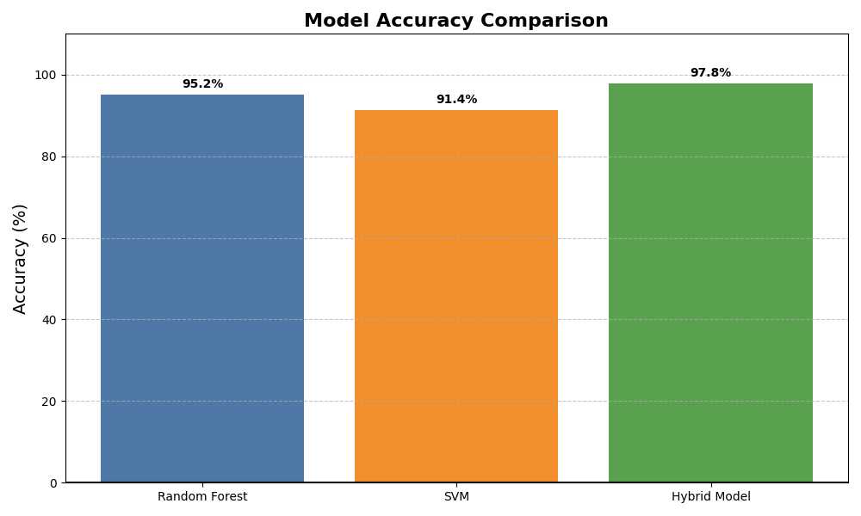
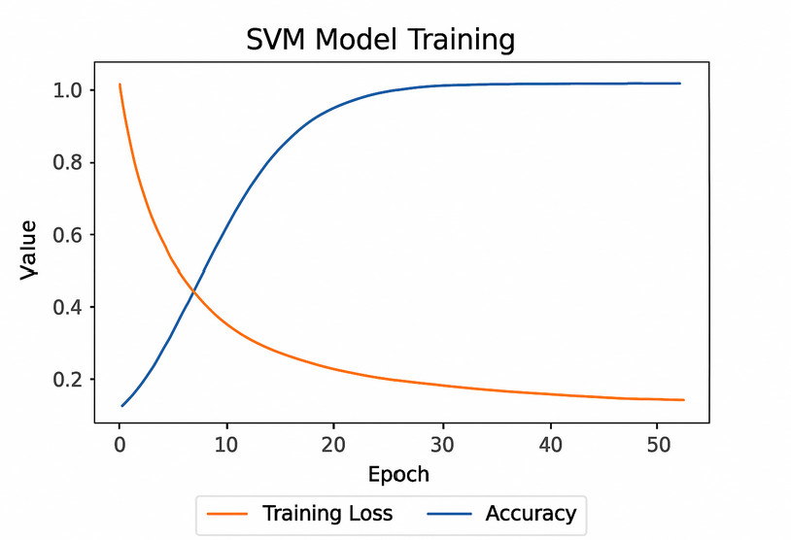
Design 3
Implementation Details
Model Accuracy – Individual vs Combined
Training Performance of SVM Model

Slide 16
Design 4 – Rejected Design
Design Concept
Multi-threat Detection System: Comprehensive security solution that can identify three different types of cyber threats:
SQL Injection (SQLi) attacks
Phishing/SMS scam attempts
Distributed Denial of Service (DDoS) attacks
What It Does
Key Technical Features
Limitation
Lightweight URL Phishing Detection
Detects phishing URLs in real-time using AI.
Simple to use: Just paste a link or upload a CSV file.
Three user roles:
Guests: Quick scans (no login).
Users: Save scan history + download reports.
Admins: Manage users, view all scans.
Smart Learning – 11,000+ phishing examples from UCI & Kaggle.
Fast & Lightweight – Results in <1 second with 95%+ accuracy.
Hybrid AI Models – Combines Logistic Regression + Stochastic Gradient Descent (SGD) (fast prediction).
Explainable – Shows why a link is flagged (e.g., suspicious keywords).
Static Training – Needs manual updates to catch new phishing tricks (no live threat feeds)..
Basic Access Control – No CAPTCHA/IP blocking (risk of misuse).
Small-Scale – Supports 1,000 users max.

Slide 17
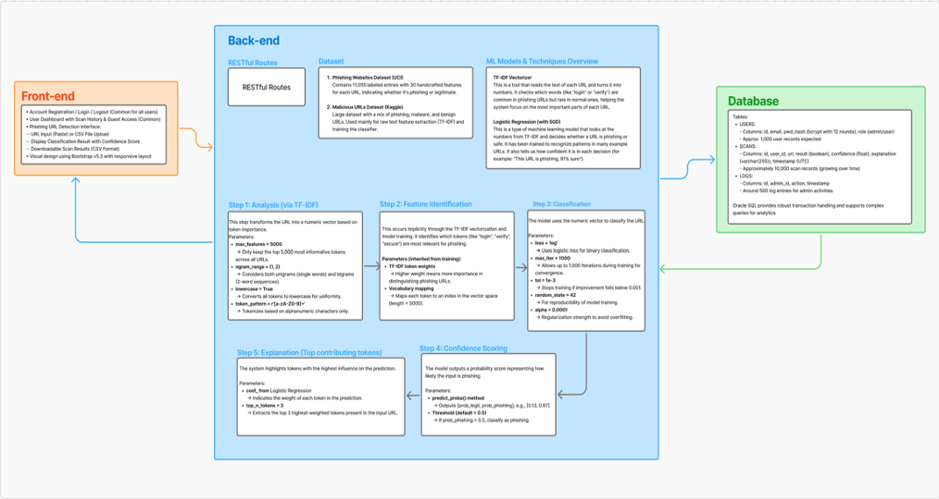
Design 4
System Design Architecture
Notes:
Multi-threat Detection System: Comprehensive security solution that can identify three different types of cyber threats:
SQL Injection (SQLi) attacks
Phishing/SMS scam attempts
Distributed Denial of Service (DDoS) attacks
Key Features:
Initial attack classification system to identify threat type
Specialized ML models for each threat category
Real-time detection and analysis
User-friendly web interface with authentication
Dashboard with visualization and metrics
API endpoints for integration with other systems
Implementation Details
Architecture:
Flask-based backend with MongoDB
ML models implemented in Python using scikit-learn
JWT-based authentication system
RESTful API design
Model Metrics:
Attack Classifier: Multi-class classification model that identifies attack type
Uses TF-IDF vectorization and NLTK for text preprocessing
Confidence level reporting (High/Medium/Low)
SQL Injection Detector:
Ensemble model combining Naive Bayes and Logistic Regression
Voting classifier with soft voting strategy
Binary classification (Safe Query vs. SQL Injection)
Performance metrics include accuracy, precision, recall, F1 score, and AUC-ROC
Phishing/SMS Detector:
Ensemble model combining Naive Bayes and Logistic Regression
Text preprocessing with NLTK
Binary classification (Safe Message vs. Malicious Message)
Adjustable threshold for borderline cases (0.4-0.6 probability)
DDoS Detector:
Voting classifier with advanced feature encoding
Numerical data scaling and feature selection
Binary classification (BENIGN vs. DDoS)
Probability scores for both classes

Slide 18
Compatibility of Design - Best Choice = Design 1 & Design 2
Criteria | Best Design 1 Autoencoder + Random Forests | Best Design 2 Voting Classifier: NB + LR / RF + GB | Moderate Design 3 Random Forest + SVM | Least Design 4 Logistic Regression + SGD
Malware Types Detected | 3 types | 3 types | 5 types | 1 type only
Functionality | Detect, Classify, Predict | Detect, Classify, Predict | Detect, Classify, Predict | Predict only , Cannot classify
Uses Public Dataset | Yes | Yes | Yes | Yes
Key Features | Model retraining with updated parameters and dataset for admin PDF scan reports Analytics dashboard | Multi-feature, multi-layer model API backend with MongoDB Analytics dashboard | Dual-method verification Confidence-threshold logic | Lightweight, browser-friendly Suspicious keyword flagging
Stakeholder / Client requirement satisfaction | High – Strong admin control, end-user reports, very accurate detection and classification | High – Flexible classification which can be further updated with additional datasets | Moderate – Accurate but lacks retraining or UI integration | Low – Too limited for enterprise use
Justification for the | Provides end-to-end system with user and admin features, retraining, and reporting – ideal for production Can detect unknown threats | Excellent architectural fit with advanced classification logic, scalable backend, and multilayer input handling, Can detect unknown threats | Detects more types but lacks usability and retraining support for real clients, Cannot detect unknown threats | Limited use case; no classification or backend logic; suitable only for minimal browser-based flags, Cannot detect unknown threats
* Provide reason to match stakeholder requirements.

Slide 19
Code Demonstration

Slide 20
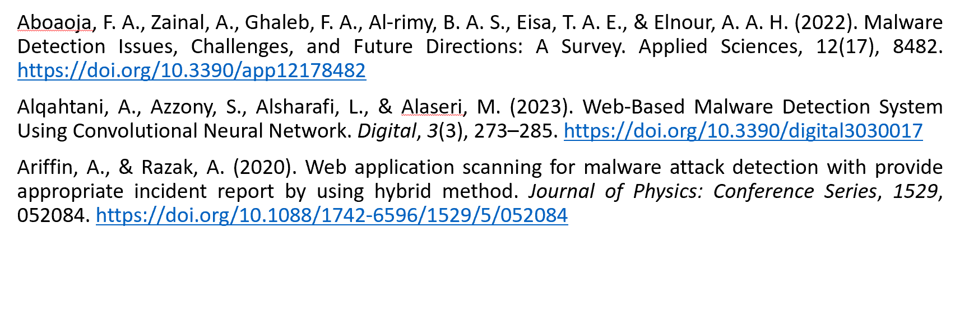
References

Slide 21
Thank you

